Slide 1

Research Activities in 1H 2010
Category: SECRET C
Information Manager: Daichi Funato
Date of Preparation: 06/29/10
Dachuan Yu
MSL & OOP

Slide 2
Overview of Research Activities
FAST: Formal Automated Specification and Testing (MSL)
  AXT scenario generation by modeling HMI specifications
  Stress testing using AXT
BASS: Web application security (MSL)
  Ported BASS onto Google App Engine
  Published invited paper at ICMU’10
  Explored open-sourcing opportunities
SEN DF: SEN Developer Framework (OOP)
  Focused on consultation to CNDD in Q1
    Extensive survey on Cloud computing and development frameworks
    Knowledge exchange sessions and tutorials on cloud architecture, platform services, and development frameworks
    Internal report on Cloud computing survey
  Research started in Q2
    To design a SEN Development Framework as an interface between Service Enablers and Platform Services
    Design stage is close to completion; will start implementation in Q3
10%
10%
80%

Slide 3
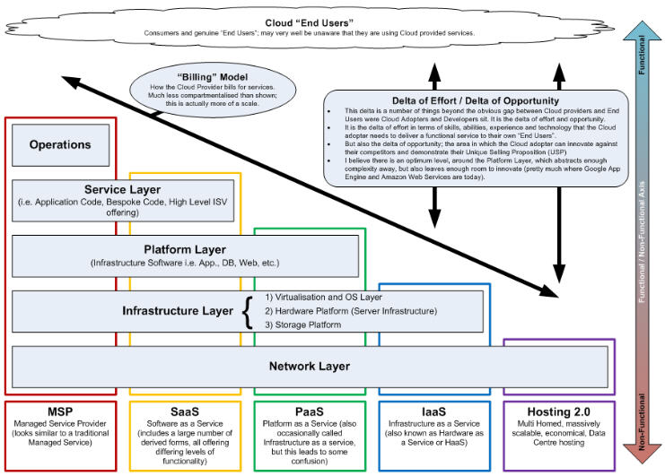
Cloud Relationship Model
Adapted from Wayne Horkan’s Model
Application Layer
(Application Code, Bespoke Code, ISV Offering)

Slide 4
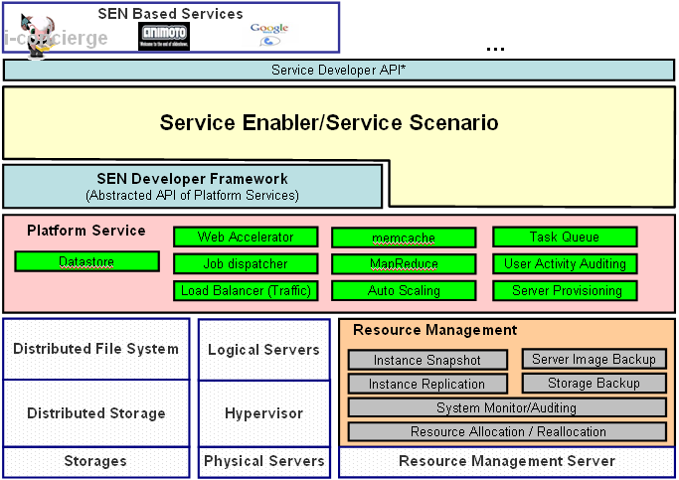
The Case for DOCOMO (SEN)
Application
Layer
Sometimes called the Service Layer
DOCOMO or 3rd-Party Service Builders
Platform
Layer
DOCOMO
Infra.
Layer
To understand SEN’s benefits to DOCOMO, consider the skills of service builders and where we would most want them focusing their efforts
  Installing and tuning operating systems and application platforms? (×)
  Writing business value focused applications and services? (√)

Slide 5
Developer Framework (DF)
Service Enabler provides common facilities on aspects specific to DOCOMO services
Developer Framework bridges the gap between the two layers
Platform Service supports the complete life cycle of building and delivering web applications and services
High level requirement from CNDD: cost reduction & ease of use

Slide 6
Features of DF
We translate the high-level requirement into the following features
Rapid development (usability)
  Should be easy to build a typical service enabler
Rapid learning (gentle learning curve)
  Should be able to learn and use advanced DF components gradually
  Developers do not have to learn the entire framework all together
Extensibility
  Should be able to accommodate future evolution of SEN
  New support can be added easily, without breaking existing code
Performance
  SE built using DF should be fast & scalable (DF should support this transparently)
  DF should support monitoring and profiling
Safety and security
  Should allow developers to focus on business logic without being distracted by common safety and security handling

Slide 7
Technology behind DF Features
This is how we are planning to realize these features
Rapid development (usability)
  Proper programming model and API set
  Convention over configuration and templating
  Development tools supporting programming, testing, deployment, monitoring
Rapid learning (gentle learning curve)
  DF is organized as a simple core plus plug-ins
  A self-contained core with well-defined interfaces for extensions
  Plug-ins have a well-defined structure; each addresses a particular area
Extensibility
  Same as above: core + plug-ins
Performance
  DF should use proper technology from lower layers based on enabler specifics
  In some situations, this can be determined automatically by DF
  The programming model should expose relevant SE properties as needed
Safety and security
  The programming model should take into account user account/profile and other common concerns of DOCOMO service enablers

Slide 8
Core DF Design
Programming model
  Developers does not deal with databases directly
  Data model is mapped to a variety of databases
  Common database issues are addressed transparently: e.g., pooling db connections, mapping objects to tuples, transactional support, etc
  Data go through a sequence of tasks for processing
  Data collection manipulated as a whole; distribution handled transparently
Common protocols
  Primitives for communicating with external resources using common protocols
  These primitives focus on the tasks to be achieved and protocols used
  Developers provide sufficient information for carrying out the protocols, and DF carries out the protocols transparently
User account management
  Provides easy access to user profile and privileges
  Associated with an access control and permission system
Others
  Convention over configuration
  Templates
  Tools

Slide 9




Supporting Data-Parallelism
Phone sends picture to server
Server compares picture with landmark indices
The Eiffel Tower is a 19th century iron lattice tower …
User takes picture of a landmark
Server sends landmark information (e.g., comments from friends) to user
Goal: to support “embarrassingly parallel” applications well
We separate the concepts of task & coordination
  “Task” can be written entirely in existing languages
    May explore core-like abstractions in the future
  “Coordination” can be supported by a collection library

Slide 10
Collection-Oriented Programming
Main idea: to manipulate a collection of data as a whole
  e.g., Fortran 90, APL, CM Lisp, Paralation Lisp, SETL
  Typical collection operations include map, reduce, filter, member test, pack, select, permute, etc.
  Key: efficient implementation on a parallel architecture
Application to the Cloud architecture
1
2
3
6
5
10
map
double
7
14
9
18

Slide 11
Application in Developer Framework
Developer framework provides efficient implementation of collection operations on the Cloud
  Will also provide common patterns such as MapReduce as libraries
Programmers work with collections without having to invoke platform services directly
  Programmers define tasks using their favorite host language and regular data structures
  The developer framework allows a collection of data to be manipulated as a whole
  The developer framework distributes tasks and conduct coordination efficiently and transparently

Slide 12
Service Programming Example
Phone sends picture to server
Server compares picture with landmark indices
The Eiffel Tower is a 19th century iron lattice tower …
User takes picture of a landmark
Server sends landmark information (e.g., comments from friends) to user
let landmark_id = (map_for_singleton (cmp_img img) landmarks) in
let friends = (get_friends user_id) in
let notes = map (get_notes landmark_id) friends in
map2 show friends notes
end

Slide 13
Novelty & Benefits
Data distribution is handled by intuitive collection-oriented primitives, as opposed to platform service interfaces
  Collection-oriented primitives handle data in parallel, whose implementation takes care of data distribution transparently
  We may want to choose whether to distribute tasks based on the computation power needed, since not all collection-based operations are computation intensive
More general than MapReduce
  It is not necessary to "reduce" after each map
  Specialized "reduce" may sometimes be more efficient
  There are useful patterns beyond MapReduce
Other programming styles (e.g., OO) would yield different code, but would be in the same spirit
let landmark_id = (map_for_singleton (cmp_img img) landmarks) in
let friends = (get_friends user_id) in
let notes = map (get_notes landmark_id) friends in
map2 show friends notes
end

Slide 14
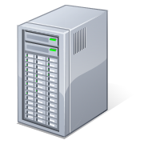

Bigger Picture
Service Enablers
SEN Developer Framework
Collection
Relational
Database
Key-Value
Pair
POSIX
Publish
Subscribe
User/Auth
Tasks
Abstract Storage
Abstract CPU
Memcached
Network
Storage
User
Activity
Auditing
Job Dispatcher
Abstract Server Cluster
Auto Scaling
Monitoring
Datastore
Server
Provisioning
Load
Balancer
Failover
Physical Server Cluster
Physical Storage

Slide 15
Service Building Exercise
Encyclopedia
Annotated
World
Navigator
DOCOMO Services
Application & Service Development Interface
Landmark
Recognition
Knowledge
Base
Social
Networking
Maps &
Directions
Service
Enablers
SEN Developer Framework
Collection
Relational
Database
Key-Value
Pair
POSIX
Publish
Subscribe
User/Auth
Tasks
Memcached
Network
Storage
User
Activity
Auditing
Job Dispatcher
Platform Services
Auto Scaling
Monitoring
Datastore
Server
Provisioning
Load
Balancer
Failover

Slide 16
Summary of Research Items
Platform services
  Will use open source software and in-house development for relevant platform services
  Most key platform services are already supported in SEN
  “Network storage” and others will be developed as needed
Developer framework (main research item)
  Design and implementation from scratch
  Will focus on developing a collection-based programming model
  Will include other support for agile development as well
Service enablers & application/service development interface
  Design of the service enabler infrastructure
  Implementation of various service enablers, such as image comparison, contents sharing, maps and directions, etc
Service building
  Development of the service logic should be straightforward
  Some additional client-side work is require for a polished demo
It should be easy to build service enablers using developer framework.
It is expected that performance will suffer a little.

Slide 17
Timelines
Theme | 2010 |  | 2011
FAST Collaboration with CDDD
BASS
SEN Developer Framework
Spec Writing Guideline
AXT Scenario Generation
AXT Random Testing
Collaboration with Prof. Koushik Sen
GAE Port
Open Sourcing
CNDD Consultation
Developer Framework
Service Composition
Service Building
Focused Research Activity
Other Research Activity
Decision Points
- Prototyping or not
- Transfer to Japan, etc.
- Prototyping
- Trial, etc.

Slide 19
Major Architectural Layers
Network layer
  Physical datacenter
Infrastructure layer
  Core computing resources and network fabric for Cloud deployment
  Servers are not viewed individually, but as a commodity in collection
Platform layer
  Software platform and components for application development
  Consists of generic platform software (e.g., database) as well as domain-specific solutions (e.g., billing) as application building blocks
  Generic platform software are often referred to as platform services
  Domain-specific solutions are often referred to as service enablers
Application layer
  The actual Cloud-based applications that end users touch
Operations
  A complete package of IT services on the Cloud, including the manpower for running and maintaining the services
e.g., hardware
e.g., virtualization
e.g., database
e.g., application
e.g., operation of application

Slide 20
Major Cloud Communities
Cloud providers
  Technology providers who build out Clouds
  E.g., Amazon, Google, Microsoft, Yahoo
  DOCOMO can be a Cloud provider
Cloud adopters/developers
  People who develop and deploy services over the Cloud, sometime also referred to as service enablers
  E.g., Facebook (running on Amazon Web Services)
  DOCOMO or a 3rd-party can be a Cloud adopter/developer
Cloud “end” users
  People who use Cloud-based services
  E.g., Facebook users
  DOCOMO customers can be end users of the DOCOMO Cloud

Slide 21
Delta of Effort/Opportunity
This “Delta” refers to the gap between the Cloud providers and the end users
  Delta of effort: skills, abilities, experience and technology that the Cloud adopter needs to deliver a functional service to end users
  Delta of opportunity: room left for the Cloud adopter to innovate
Effort and opportunity go hand in hand
  The more capability procured from the Cloud provider (i.e. higher up the stack), the less the Cloud adopter has to do
  The less procured from the Cloud provider, the more opportunity the Cloud adopter has for engineering differentiating technology
In many cases, an optimal level lies around the platform layer
  Abstracts enough complexity away (i.e. you don't have to procure servers, networks, implementation or technology operations staff)
  Leaves enough room to innovate and produce software engineered value
  Successful platform layer offerings include Amazon Web Services, Google App Engine, Yahoo! Cloud, Windows Azure, etc

Slide 22
The Platform Layer
The platform layer delivers a computing platform and common software components to facilitate the development of Cloud applications
  It consumes the core computing resources and network fabric provided by the infrastructure layer
  It further provides common software solutions so that Cloud application development can be almost as easy as PC application development
The platform layer consists of
  Platform services: common platforms shared across a wide range of applications
  Service enablers: domain-specific solutions shared by specific groups of applications
Essentially everything developers need in a PC OS, such as file system, storage, and scaling
Essentially specialty libraries for building particular kinds of applications

